Slide 1
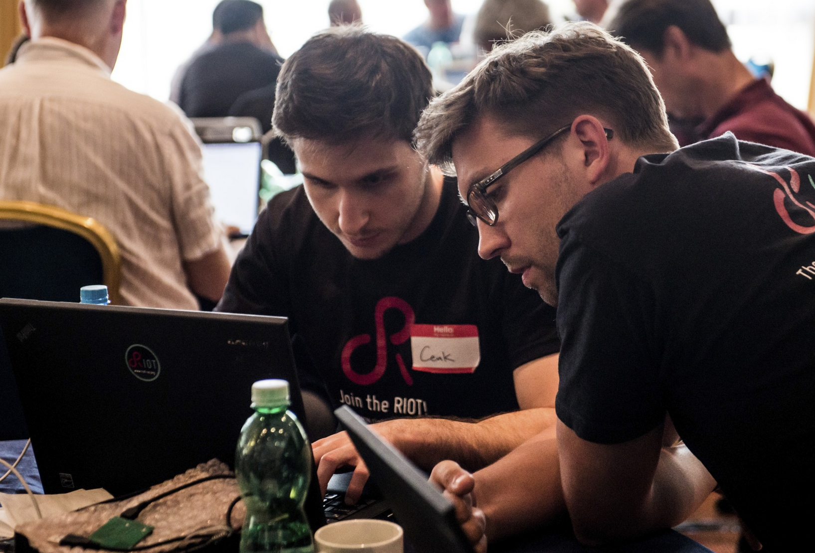
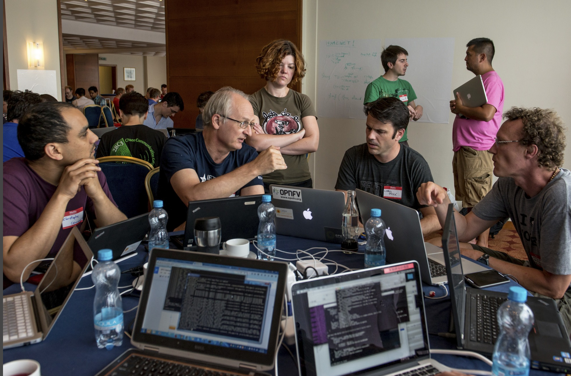
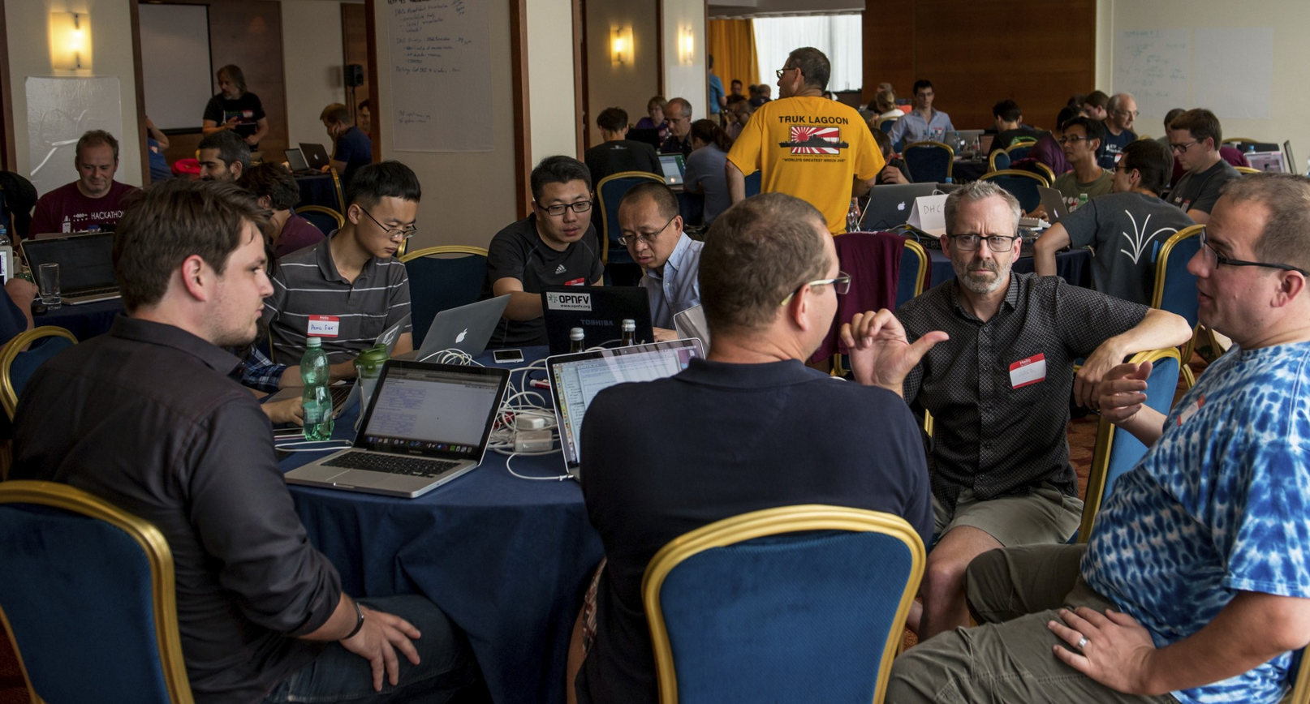
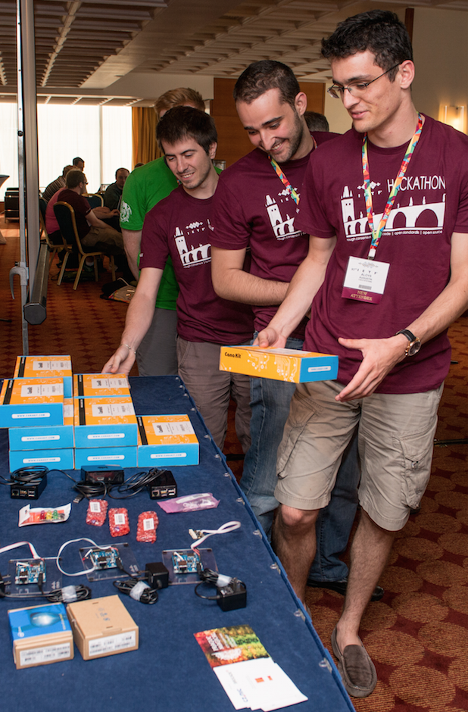
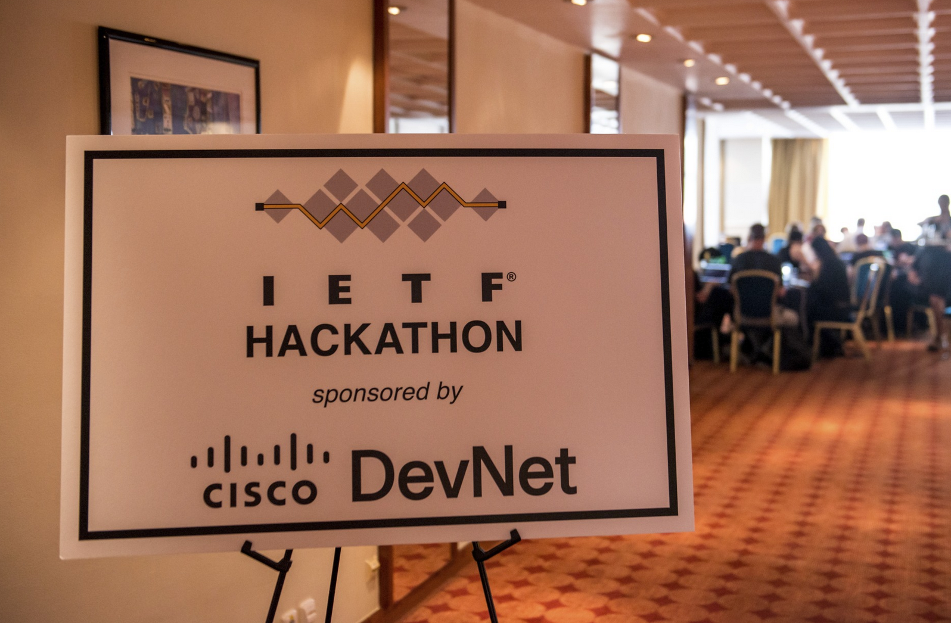
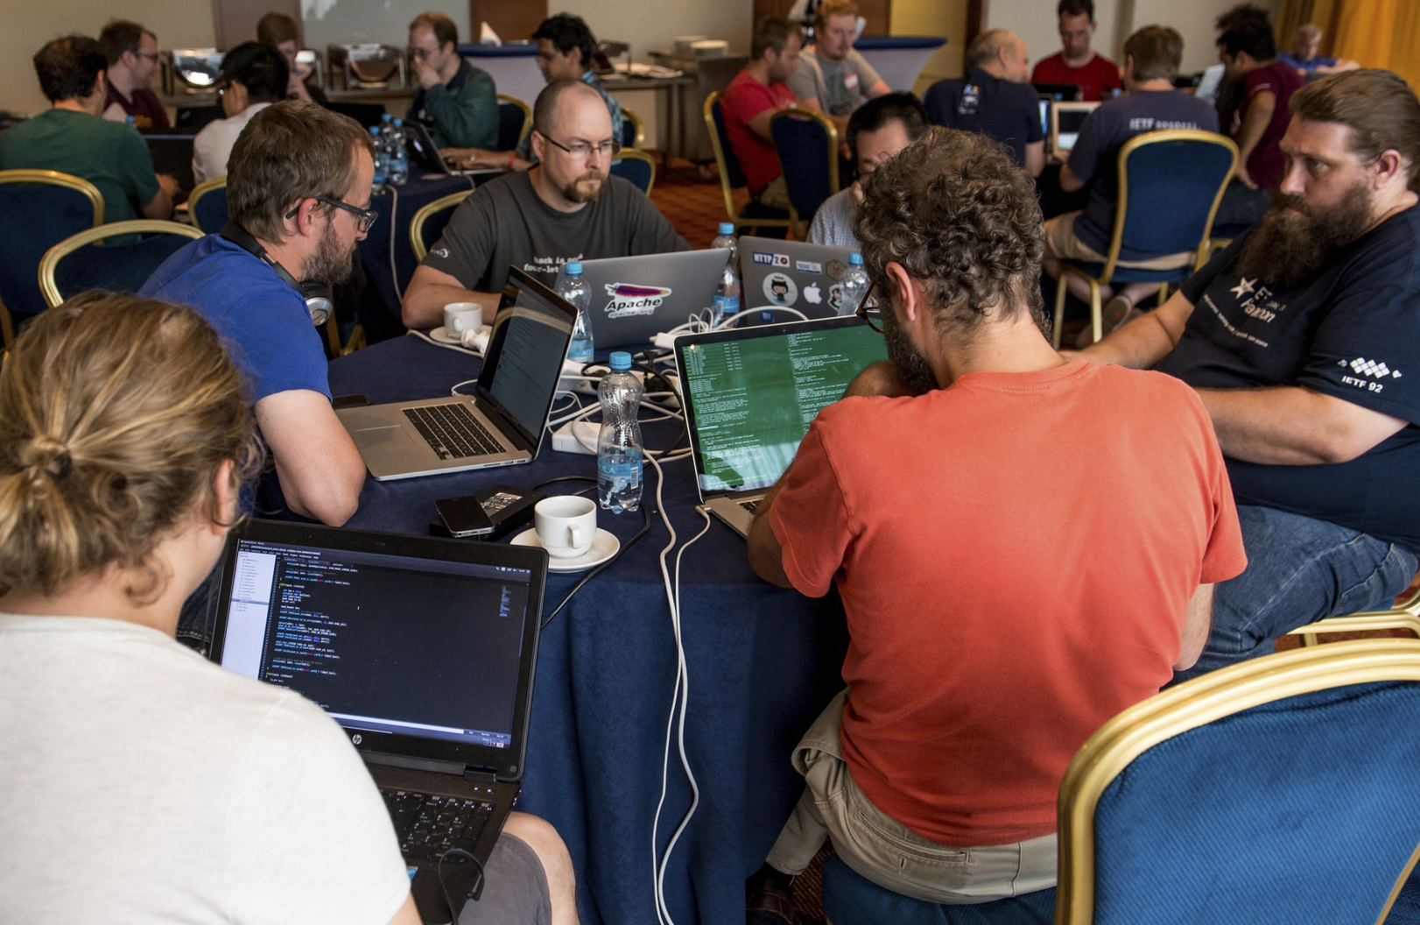
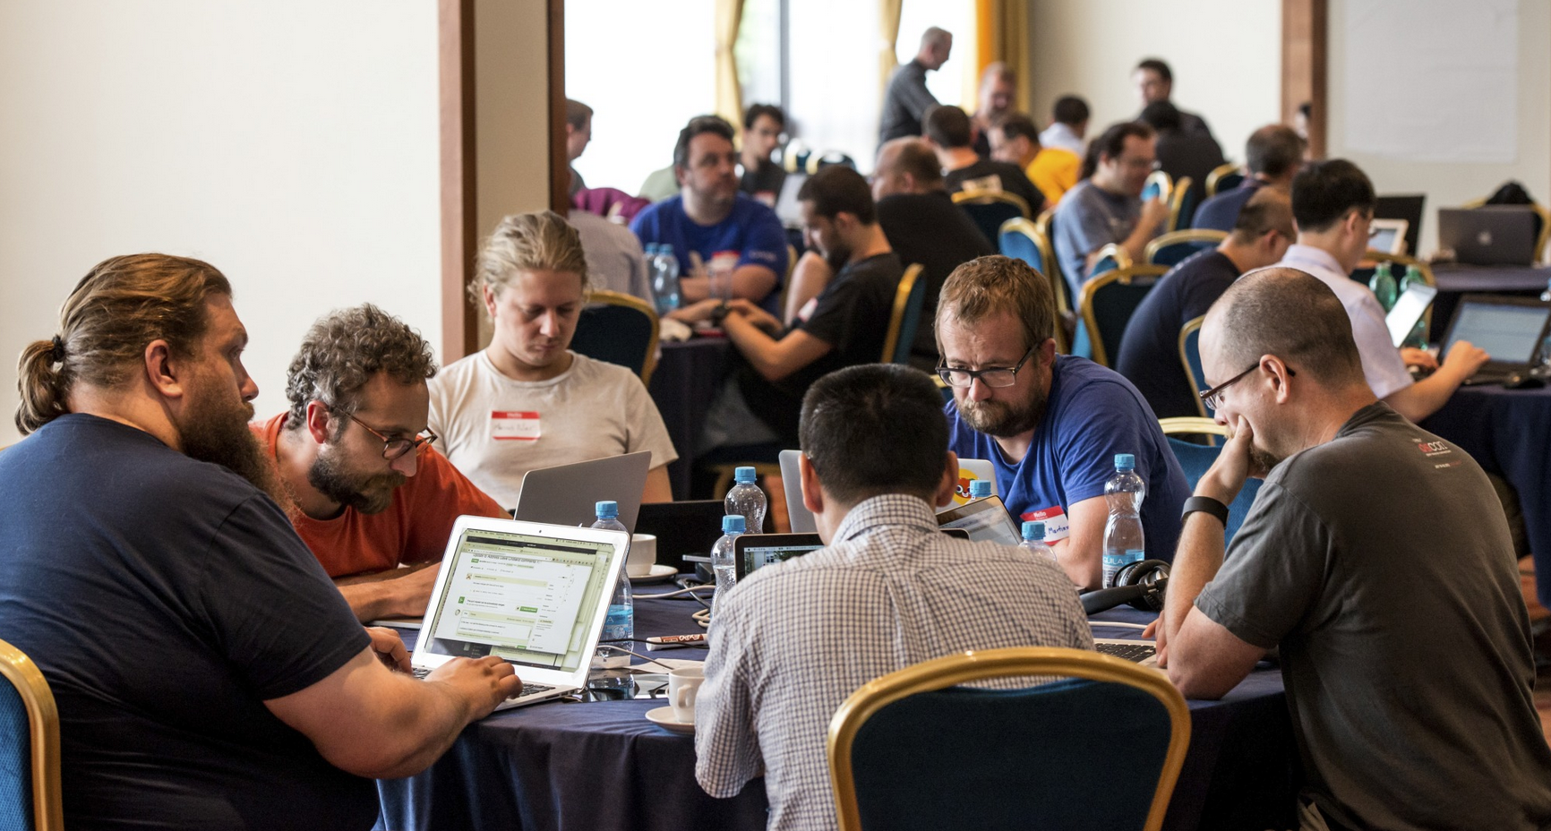
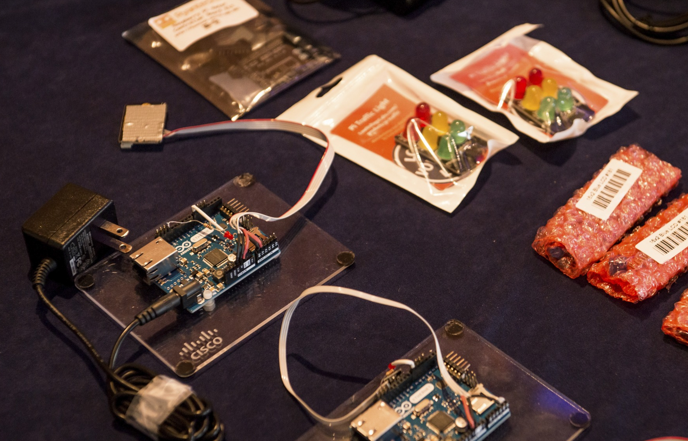
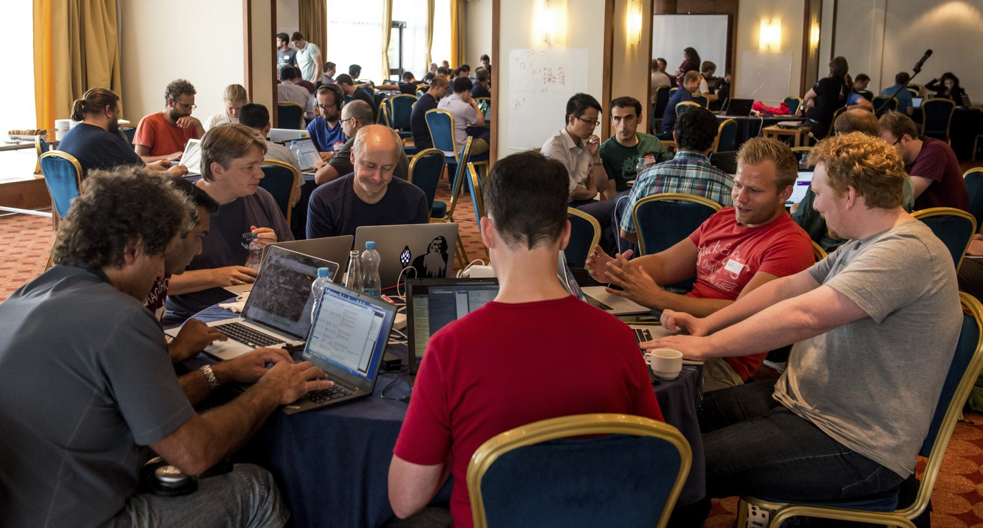
© Stonehouse Photographic / Internet Society

Slide 2
DNS / DNSSEC / DANE / DPRIVE
Platform Used
Team Organizations
ACLU, Cloudflare, ISOC,
NLnet Labs, No Mountain,
Salesforce, Sinodun,
Verisign Labs, W3C
Winner of a
Best in Show
Interested folks:
BOF in Istanbul Room following Bits-n-Bites
Projects Developed
DNS-over-TLS privacy – add authentication and forward secrecy
DNSSEC roadblock tester
DNSSEC algorithm visualizer
Algorithm registry fetch tool
TLS DNSSEC chain extension server demo
DEMO
AVAILABLE

Slide 3
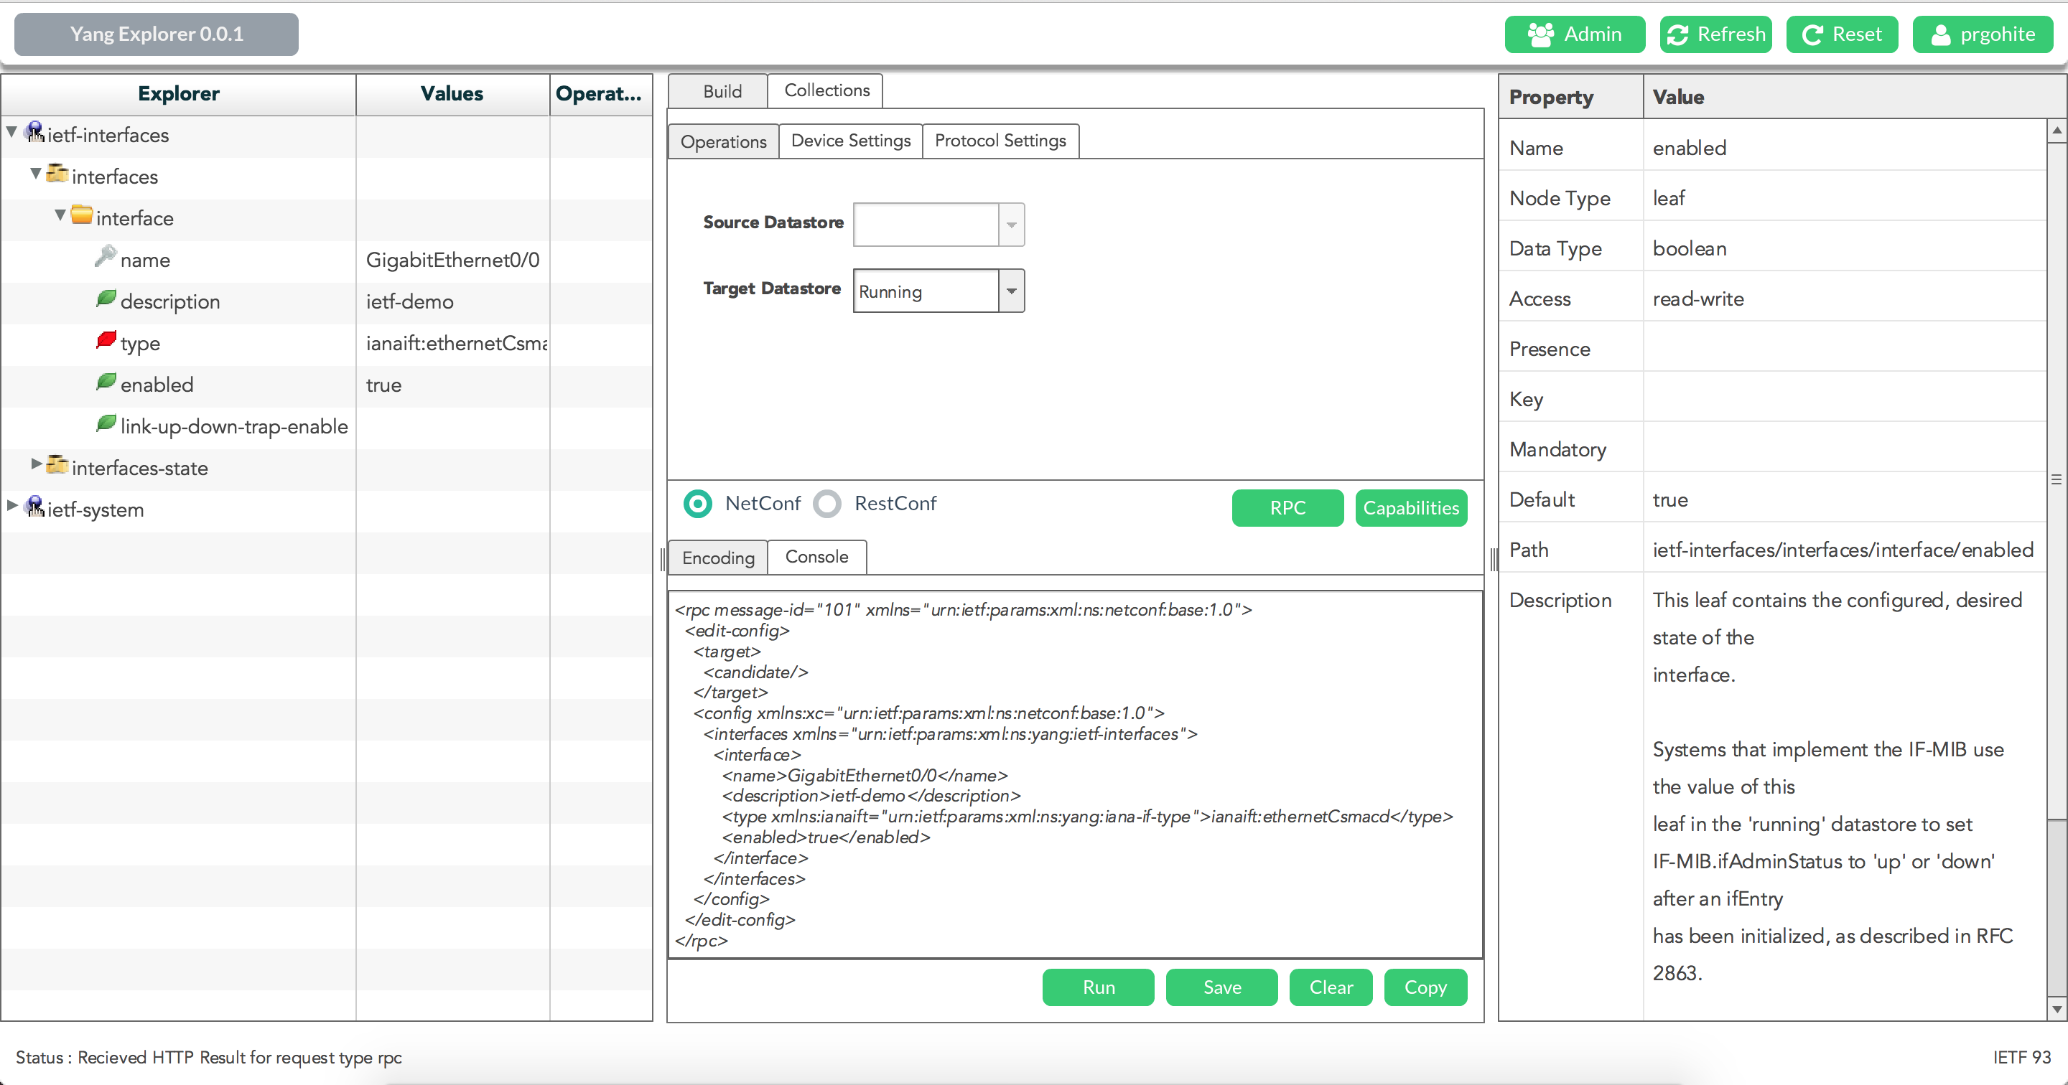
Yang Explorer
Client-Server Web / Desktop app
Browse YANG data models
Inspect properties of nodes
Create and Execute NetConf / RestConf RPCs
XML and JSON encoding
Open Source
coming soon …

